Slide 1
www.jamaatwomen.org

Slide 2
www.jamaatwomen.org

Slide 3
www.jamaatwomen.org

Slide 4
www.jamaatwomen.org

Slide 5
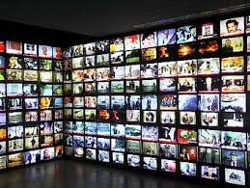
www.jamaatwomen.org

Slide 6
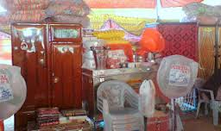
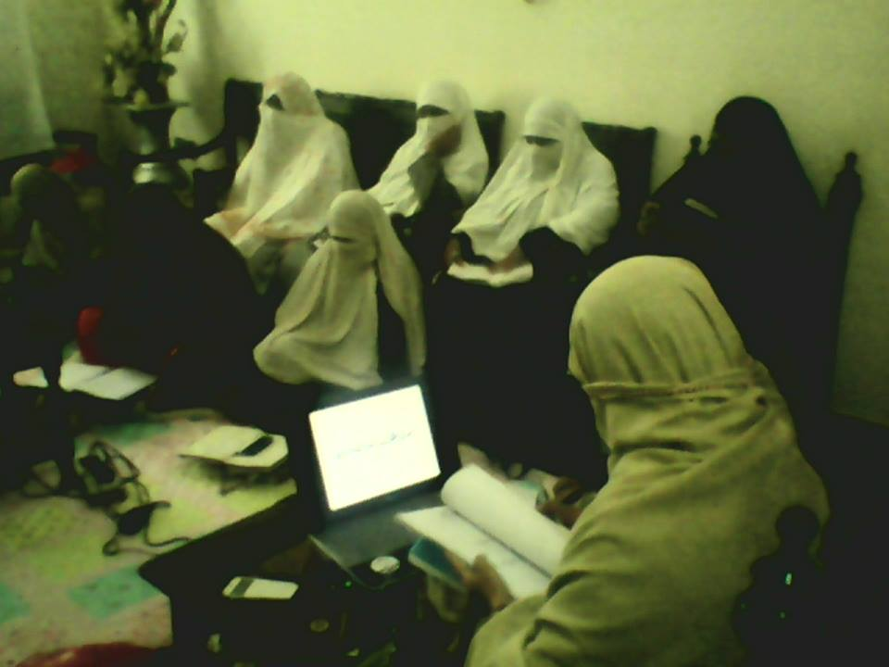
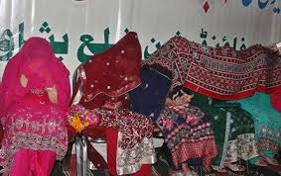
www.jamaatwomen.org

Slide 7
www.jamaatwomen.org

Slide 8
www.jamaatwomen.org

Slide 9
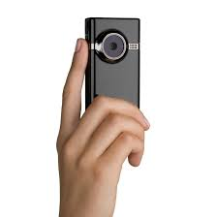
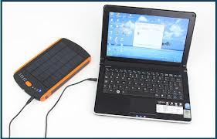
www.jamaatwomen.org

Slide 10
www.jamaatwomen.org

Slide 11
www.jamaatwomen.org

